Slide 1

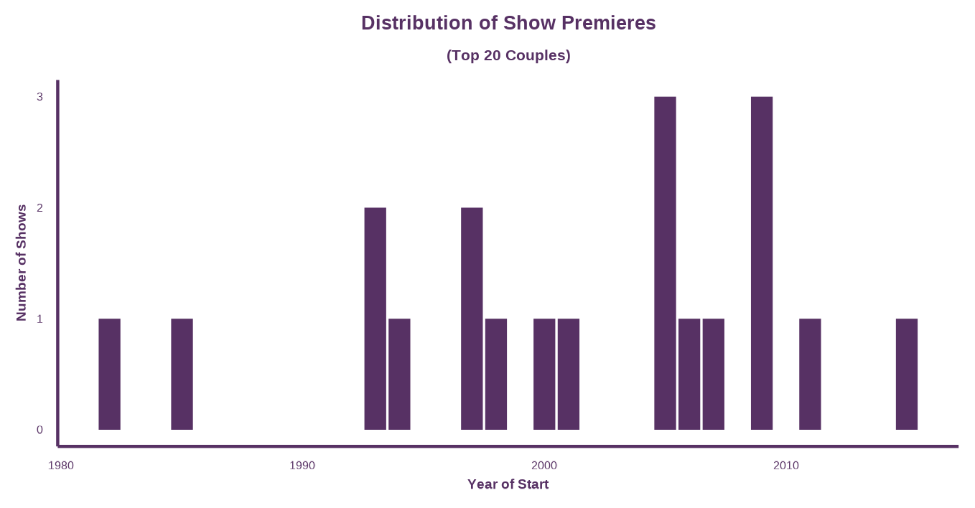
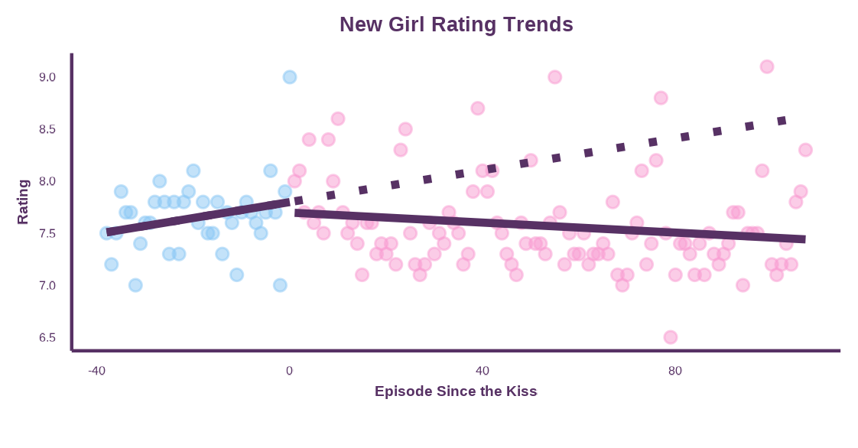
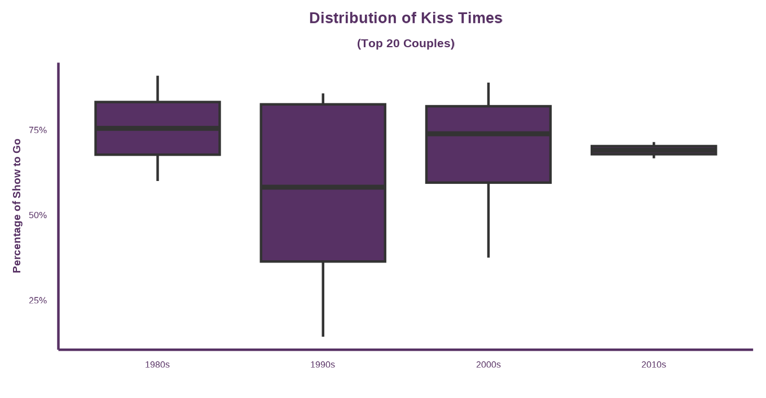
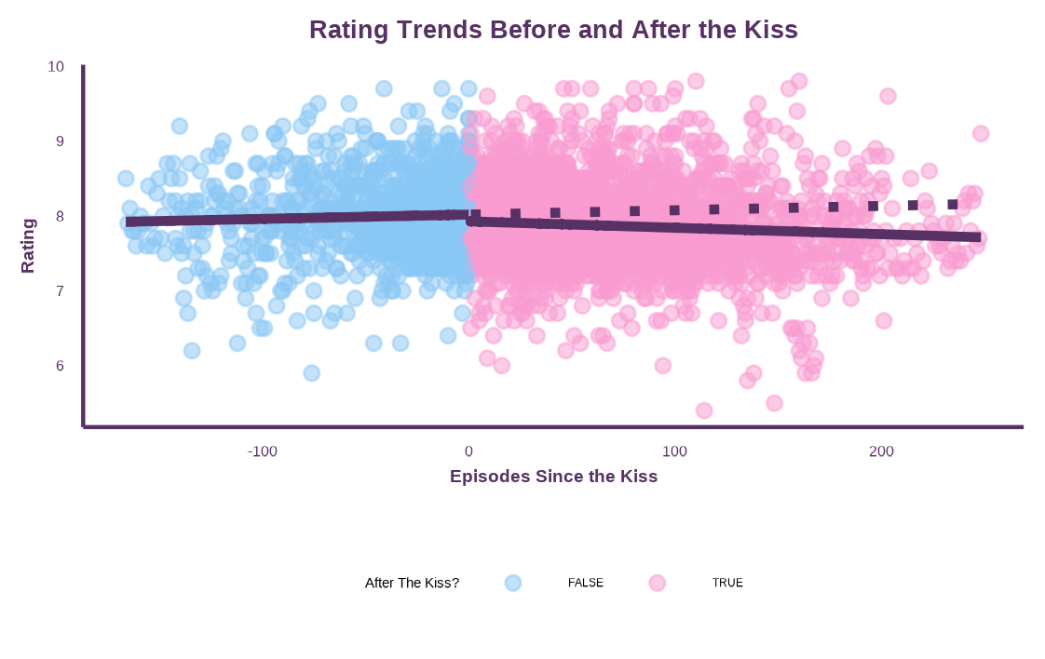

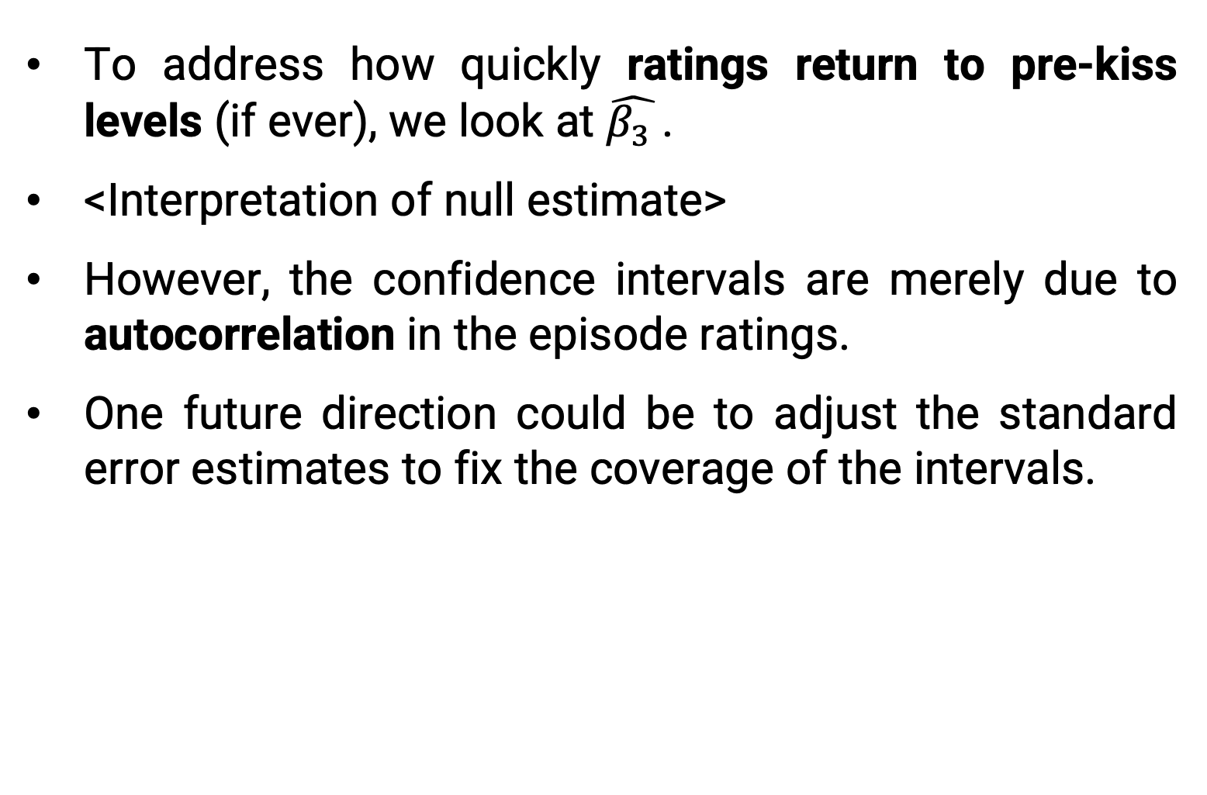
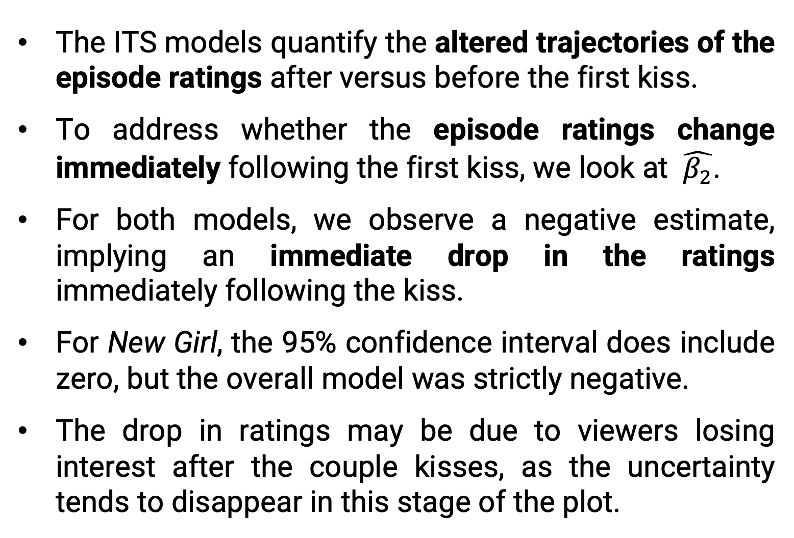
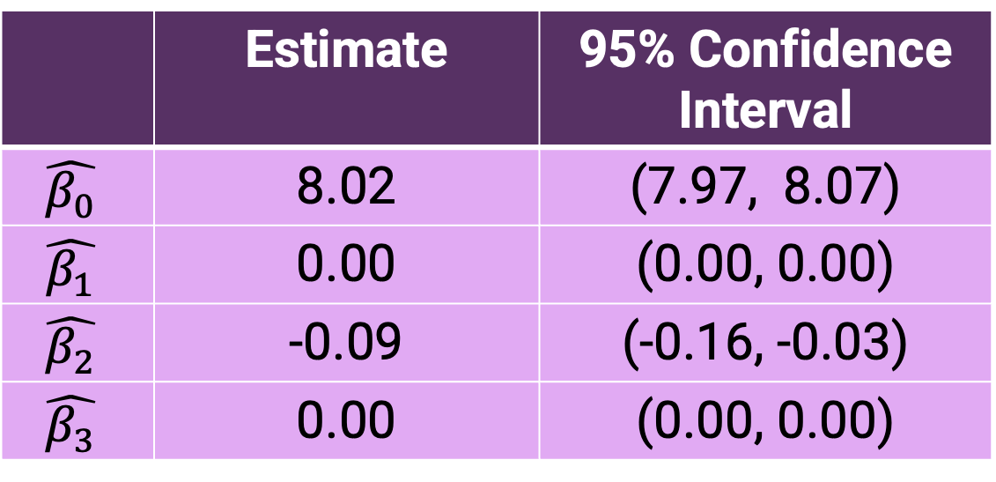

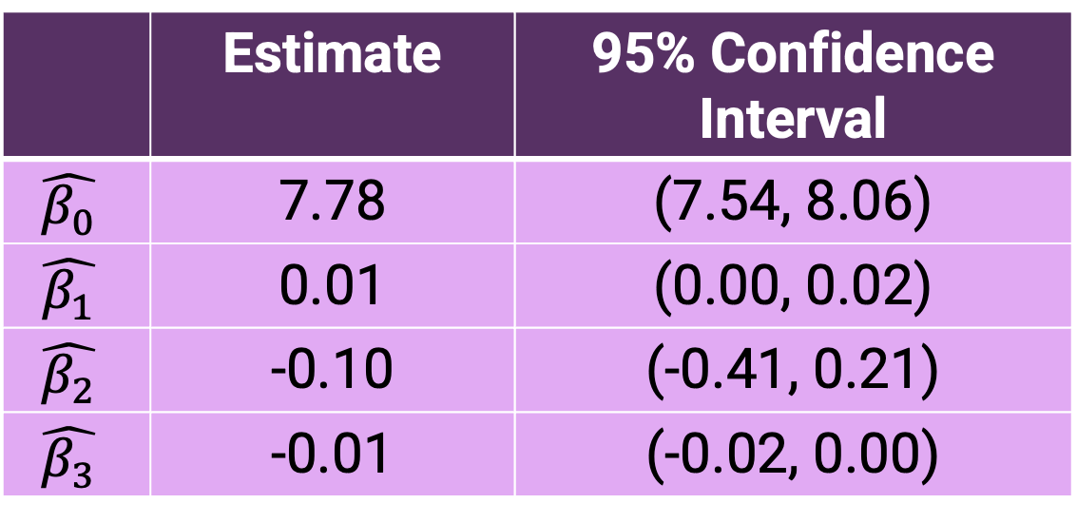
Rate This Interruption: Using Interrupted Time Series Techniques to Analyze Popular Television Couples and Episode Ratings
Ashley E. Mullan, Lucy D’Agostino McGowan, Sarah C. Lotspeich
Department of Statistical Sciences, Wake Forest University, Winston-Salem, North Carolina
INTRODUCTION
RESULTS
Many television (TV) shows follow the “will they or won’t they” trope, where the dynamic between a pair of characters constantly shifts between almost-romance and friendship.
The couple demonstrates romantic chemistry, but their future is plagued by uncertainty and conflict.¹
This trope has persisted throughout the decades, and examples include Sam and Diane from the 1980s show Cheers and Jess and Nick from the 2010s show New Girl.
The audience may wait multiple seasons before the couple gets together; some suspect producers delay it to create suspense and keep viewers engaged.
Events marking major romantic milestones, like the couple’s first kiss, often change the plot trajectory, influence the number of viewers and impact ratings.
Table 1: Parameter Estimates – New Girl
 | Estimate | 95% Confidence Interval
$$\hat{β_{0}}$$ | 7.78 | (7.54, 8.06)
$$\hat{β_{1}}$$ | 0.01 | (0.00, 0.02)
$$\hat{β_{2}}$$ | -0.10 | (-0.41, 0.21)
$$\hat{β_{3}}$$ | -0.01 | (-0.02, 0.00)
Figure 1: Distribution of Show Premieres The “will they or won’t they” trope has persisted from as early as the 1980s to today.
Figure 3: ITS Model Results After the first kiss airs, the ratings decrease on average. This trend persists both at the show level (above) and overall (below).
Table 2: Parameter Estimates – Overall
METHODS
 | Estimate | 95% Confidence Interval
$$\hat{β_{0}}$$ | 8.02 | (7.97, 8.07)
$$\hat{β_{1}}$$ | 0.00 | (0.00, 0.00)
$$\hat{β_{2}}$$ | -0.09 | (-0.16, -0.03)
$$\hat{β_{3}}$$ | 0.00 | (0.00, 0.00)
Data
Through publicly available rankings, the 20 most-cited “will they or won’t they” TV couples were identified.
Data about couple-show pairings were collected from the Internet Movie Database (IMDb)³ and Wikipedia⁴.
Variables of interest include the timing of the first kiss, the couples’ internet popularity, the number of seasons, the year of premiere, and episode ratings.
Analysis
An interrupted time series (ITS) model was used to examine the impact of a couple’s first kiss (the interruption) on a show’s per-episode $\hat{Rating}=$
$${\hat{β}}_{0}+{\hat{β}}_{1}Episode+{\hat{β}}_{2}AfterKiss+{\hat{β}}_{3}Episode×AfterKiss$$
This model was fit at two levels: 1) show-specific, considering only Jess and Nick from New Girl and 2) all shows, considering all 20 most-cited couples.
Figure 2: Distribution of Kiss Times Except for those premiering in the 1990s, most shows chose to cut the trope short. The median couple for each decade has their first kiss with over two-thirds of the show left to go.
DISCUSSION AND CONCLUSION
REFERENCES
The ITS models quantify the altered trajectories of the episode ratings after versus before the first kiss.
To address whether the episode ratings change immediately following the first kiss, we look at $\hat{β_{2}}$.
For both models, we observe a negative estimate, implying an immediate drop in the ratings immediately following the kiss.
For New Girl, the 95% confidence interval does include zero, but the overall model was strictly negative.
The drop in ratings may be due to viewers losing interest after the couple kisses, as the uncertainty tends to disappear in this stage of the plot.
To address how quickly ratings return to pre-kiss levels (if ever), we look at $\hat{β_{3} }$.
<Interpretation of null estimate>
However, the confidence intervals are merely due to autocorrelation in the episode ratings.
One future direction could be to adjust the standard error estimates to fix the coverage of the intervals.
1. https://en.wiktionary.org/wiki/will-they-won%27t-they
2. https://pubmed.ncbi.nlm.nih.gov/27283160/
3. https://www.imdb.com/
4. https://www.wikipedia.org/
Episode-on-Episode Change Before First Kiss
Difference in After Change Before First Kiss
Immediate Change After First Kiss
Notes:
How to best cite all the sources. Sentence about them living in the QR code? Which does need to be fixed LOL

Slide 2
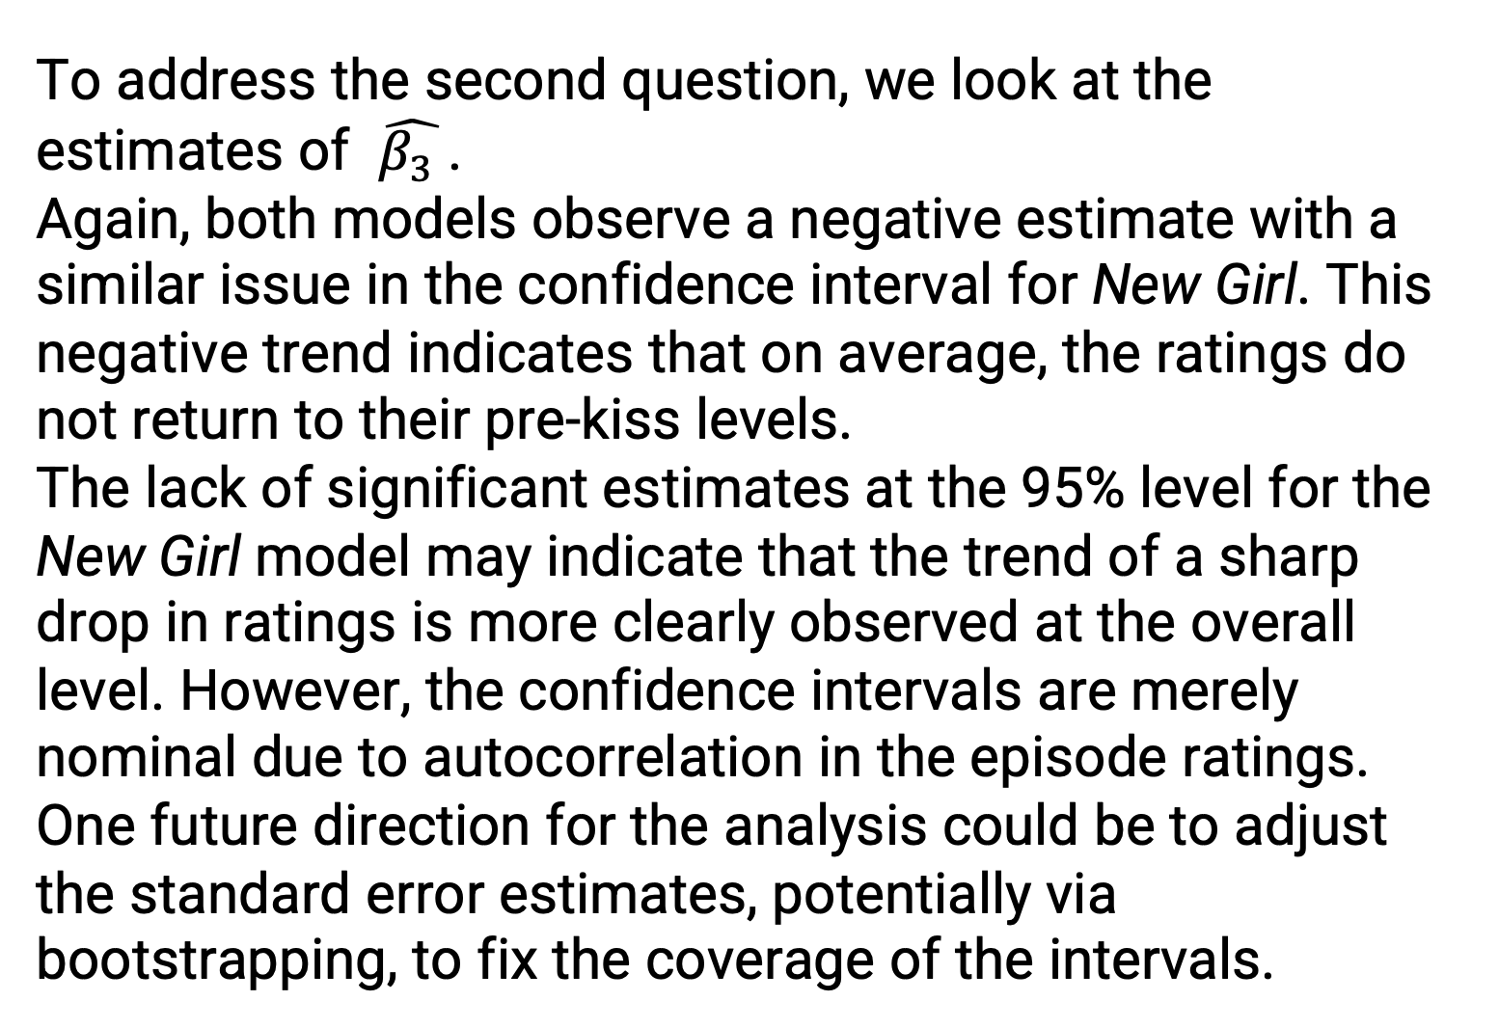
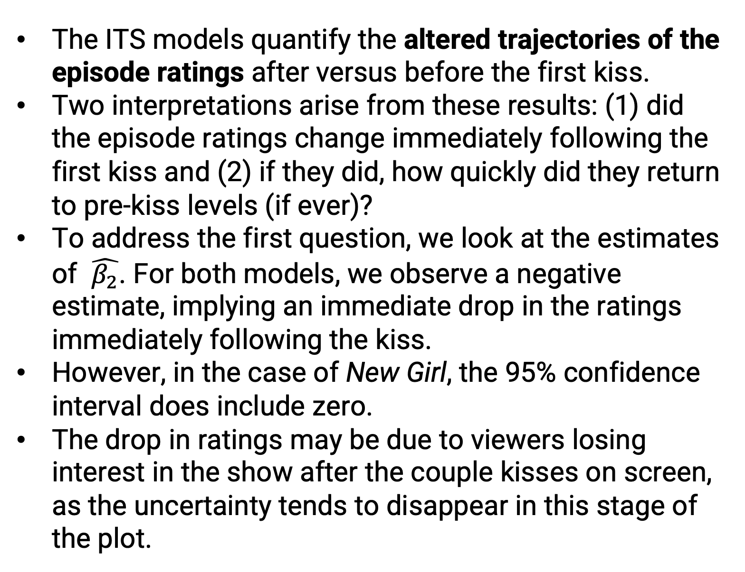

Rate This Interruption: Using Interrupted Time Series Techniques to Analyze Popular Television Couples and Episode Ratings
Ashley E. Mullan, Lucy D’Agostino McGowan, Sarah C. Lotspeich Department of Statistical Sciences, Wake Forest University, Winston-Salem, North Carolina, USA
INTRODUCTION
RESULTS
Many television (TV) shows follow the “will they or won’t they” trope, where the dynamic between a pair of characters constantly shifts between almost-romance and friendship.
The couple demonstrates romantic chemistry, but their future is plagued by uncertainty and conflict.¹
This trope has persisted throughout the decades, and examples include Sam and Diane from the 1980s show Cheers and Jess and Nick from the 2010s show New Girl.
The audience may wait multiple seasons before the couple gets together; some suspect producers delay it to create suspense and keep viewers engaged.
Events marking major romantic milestones, like the couple’s first kiss, often change the plot trajectory, influence the number of viewers and impact ratings.
1) Show-Specific Model (New Girl)
 | Estimate | 95% Confidence Interval
$$\hat{β_{0}}$$ | 7.78 | (7.54, 8.06)
$$\hat{β_{1}}$$ | 0.01 | (0.00, 0.02)
$$\hat{β_{2}}$$ | -0.10 | (-0.41, 0.21)
$$\hat{β_{3}}$$ | -0.01 | (-0.02, 0.00)
Figure 1: Distribution of Show Premieres The trope persists from as early as the 1980s to today.
Figure 3: ITS Model Results After the first kiss episode airs, the ratings decrease on average. This trend persists at the show level (above) and overall (below).
2) Overall Model (Top 20 Couples)
METHODS
 | Estimate | 95% Confidence Interval
$$\hat{β_{0}}$$ | 8.02 | (7.97, 8.07)
$$\hat{β_{1}}$$ | 0.00 | (0.00, 0.00)
$$\hat{β_{2}}$$ | -0.09 | (-0.16, -0.03)
$$\hat{β_{3}}$$ | 0.00 | (0.00, 0.00)
Data
Through publicly available rankings, the 20 most-cited “will they or won’t they” TV couples were identified.
Data about couple-show pairings were collected from the Internet Movie Database (IMDb)³ and Wikipedia⁴.
Variables of interest include the timing of the first kiss, the couples’ internet popularity, the number of seasons, the year of premiere, and episode ratings.
Analysis
An interrupted time series (ITS) model was used to examine the impact of a couple’s first kiss (the interruption) on a show’s per-episode $\hat{Rating}=$
$${\hat{β}}_{0}+{\hat{β}}_{1}Episode+{\hat{β}}_{2}AfterKiss+{\hat{β}}_{3}Episode×AfterKiss$$
This model was fit at two levels: 1) show-specific, considering only Jess and Nick from New Girl and 2) overall, considering all 20 most-cited couples.
Figure 2: Distribution of Kiss Times Except for those premiering in the 1990s, most of the shows chose to cut the trope short. The median couple for each decade has their first kiss with over two thirds of the show left to go.
DISCUSSION AND CONCLUSION
REFERENCES
The ITS models quantify the altered trajectories of the episode ratings after versus before the first kiss.
Two interpretations arise from these results: (1) did the episode ratings change immediately following the first kiss and (2) if they did, how quickly did they return to pre-kiss levels (if ever)?
To address the first question, we look at the estimates of $\hat{β_{2}}$. For both models, we observe a negative estimate, implying an immediate drop in the ratings immediately following the kiss.
However, in the case of New Girl, the 95% confidence interval does include zero.
The drop in ratings may be due to viewers losing interest in the show after the couple kisses on screen, as the uncertainty tends to disappear in this stage of the plot.
To address the second question, we look at the estimates of $\hat{β_{3} }$.
Again, both models observe a negative estimate with a similar issue in the confidence interval for New Girl. This negative trend indicates that on average, the ratings do not return to their pre-kiss levels.
The lack of significant estimates at the 95% level for the New Girl model may indicate that the trend of a sharp drop in ratings is more clearly observed at the overall level. However, the confidence intervals are merely nominal due to autocorrelation in the episode ratings. One future direction for the analysis could be to adjust the standard error estimates, potentially via bootstrapping, to fix the coverage of the intervals.
1. https://en.wiktionary.org/wiki/will-they-won%27t-they
2. https://pubmed.ncbi.nlm.nih.gov/27283160/
3. https://www.imdb.com/
4. https://www.wikipedia.org/
Episode-on-Episode Change Before First Kiss
Difference in After Change Before First Kiss
Immediate Change After First Kiss
Notes:
How to best cite all the sources. Sentence about them living in the QR code? Which does need to be fixed LOL

Slide 3
HEADING HERE
Poster Presenter₁, Author Two₁, Author Three₂, Author Four₃
1. Institution One, Location, Country,
2. Institution Two, Location, Country,
3. Institution Three, Location, Country
Logo goes here
INTRODUCTION
RESULTS
Introduction text
Results text
Figure 3: Title of figure
Caption
METHODS
Figure 2: Title of figure
Caption
Results text
Figure 1: Title of figure
Caption
DISCUSSION AND CONCLUSION
REFERENCES
Discussion/Conclusion text
Discussion/Conclusion text
References/acknowledgements s+ optional QR code

Slide 4
HEADING FONT
Subheading font
ONE PANEL WIDTH
TWO PANEL WIDTH
Colour palette
ONE PANEL WIDTH
TWO PANEL WIDTH
ONE PANEL WIDTH
TWO PANEL WIDTH
ONE PANEL WIDTH
TWO PANEL WIDTH
ONE PANEL WIDTH
TWO PANEL WIDTH
One panel width text box + optional background colour
Two panel width text box + optional background colour
Two panel width text box + optional background colour
Figure Box: Title of figure
Caption
THREE PANEL WIDTH
THREE PANEL WIDTH
THREE PANEL WIDTH
THREE PANEL WIDTH
THREE PANEL WIDTH
Three panel width text box + optional background colour
Three panel width text box + optional background colour
Three panel width text box + optional background colour

